Slide 1
What do we do when school is out?
Establishing sustainable school mental health programs
Chris Haines, ms, lpc-a

Slide 2
The question
What do we do when school is out?!?

Slide 3
The problems
Client No Shows
Many service providers for children, adolescents, and families shift from community-based and school-based service models to outpatient service models during school breaks.
Children, adolescents, and families often see school breaks as breaks from “everything,” not just breaks from school.
As a result, children, adolescents, and families no show for appointments or cancel therapeutic services during school breaks.

Slide 4
The problems
Client Regression
When children, adolescents, and families no show, cancel, or drop out of services, many regress.
Regression increases the likelihood of hospitalization, incarceration, out of home placement, and other serious family disruptions.
Regression means therapists and schools must work harder and longer to re-establish engagement and progress when school returns.

Slide 5
The problems
Cost
School mental health programs and the community mental health centers that establish them lose revenue from billable services when clients no show, cancel, or drop out during school breaks.
Community mental health centers can be responsible for financially supporting out of home placements for children who regress, which increases their cost.
Operating costs for school mental health programs and personnel continue during school breaks.

Slide 6
Expanding our mission
The mission of a community mental health center is to help people become more positive and productive members of their communities.
During the school year, school mental health clinicians are able to focus heavily on helping clients improve functioning in school and at home.
When do we move from school and home into the community?
When do we move from the therapy office into practical application for our clients?
School breaks are an opportunity to help children learn the skills and abilities they need for being positive and productive members of their communities.

Slide 7
The goal
Engaging Services
Sustainable Programs
Resilient Communities
Effective Treatment

Slide 8
The barriers
Transportation
Motivation
Resources

Slide 9
The barriers
Overcoming transportation barriers: How can we get services to children?
Overcoming motivation barriers: How do we incorporate things that children, adolescents, and parents value into services that we can provide during school breaks?
Overcoming resource barriers: How can we get what we need to make these services happen?

Slide 10
The solutions: transportation options
If we wait for children and families to come to us, the problems and barriers will persist. We must get services to them.
Options may include:
Reserving vehicles your center already owns
Renting vehicles from state fleet management
Renting vehicles from private companies
Rending or borrowing vehicles from local churches
Renting or borrowing vehicles from local schools
Using personal vehicles and getting mileage reimbursement

Slide 11
The solutions: Engaging services
If we want children, adolescents, and families to show for services, we need to consider what they VALUE.
We must overcome the barriers that prevent them from engaging in services during school breaks just as we do when school is in session!

Slide 12
The solutions: engaging services
Motivation = Value x Expectation
If value is negative, then motivation is negative.
If expectation is negative, then motivation is negative.
If value and expectation are negative, then motivation is positive. Often they are just motivated in a different direction than we would like.
We must increase the value of the services we are offering and increase the expectation of what children, adolescents, and families can get. Give the clients and families what they value and expect in order to increase their motivation to remain engaged in treatment.
Source: Dr. Rick Griffin

Slide 13
The solutions: engaging services
Let’s Empathize
When you, your children, or your family have a “break,” what do you want?
When children have school breaks, what do they want to experience?
When adolescents are on school breaks, what do they want to do?
When children and adolescents are out of school, what do their parents need?

Slide 14
Activities in your area
For Children
______________________________
______________________________
______________________________
______________________________
______________________________
______________________________
For Adolescents
______________________________
______________________________
______________________________
______________________________
______________________________
______________________________

Slide 15
The solutions: engaging services
Each of the activities in your area, whether free or with a cost, provides an opportunity to motivate children and adolescents to attend.
What skills, abilities, and relationships do children and adolescents need to succeed in these activities?
Skills and Abilities:
____________________________
____________________________
____________________________
Relationships:
____________________________
____________________________
____________________________

Slide 16
The solutions: engaging services
What services can you provide that help children to learn the skills and abilities they need or the relationships they need?
Individual Therapy
Group Therapy
PRS
Behavior Modification

Slide 17
THE tools: therapeutic services
Individual Therapy
Group Therapy
Psychosocial Rehabilitation Services
Behavior Modification
GOAT (Great Outdoor Adventure Trips)
Greenville, SC

Slide 18
Individual therapy
When we conceptualize this service, we far too often use an adult, outpatient model of “sitting and talking.”
Individual therapy for children and adolescents certainly involves talking, but it may need less “sitting” and more “doing.”
What are some things you do when you need to talk with a child or adolescent who cannot or will not “sit.”
Consider accepted theories and evidence-based treatment models.
Play Therapy: a form of therapy using play to help children to express and communicate feelings
TF-CBT: an evidence-based treatment that includes in vivo (meaning “in real life”) application of coping skills and improved thinking learned in previous parts of the model to overcome avoidance and reduce the interference of anxiety or trauma on daily functioning.

Slide 19
Individual therapy
Can individual therapy be used as you are helping children when school is out?
Are you helping children or adolescents to develop the skills and abilities needed to function positively in their communities?
Are you helping children and adolescents develop the relationships and activities needed for healthy social functioning?
Do DLA-20 results indicate areas of disturbance in life functioning that need to be addressed in “real life” settings or situations?

Slide 20
Individual therapy
Individual therapy in community-based settings and situations allows you to move out of an office and into “real life” to help your client.
In vivo treatment allows you to understand areas of strength, and it helps you to see areas of lagging or lacking skills in your client’s functioning.
YMCA Camp Greenville Outdoor Ropes Course
Cleveland, SC

Slide 21
Group therapy
Children and teens often desire to be more connected during school breaks.
Small groups of peers can motivate children and adolescents to engage in services.
Groups are powerful tools in helping children and adolescents to develop strong social relationships and communication skills.

Slide 22
Group therapy
Group therapy brings peers together to target common treatment goals.
This service is designed to be time limited and often should have a specific start date and end date.
10 weeks of summer break is an ideal time to use group therapy to enhance the treatment progress of your clients.
First Baptist Church, Greenville, SC
Activities and Youth Ministry Center

Slide 23
Group therapy: Piedmont center for mental health services’ Use of group therapy
Brenda K. Lipe, M.Ed, LPCS
Coordinator
School-Based Mental Health Programs
Piedmont Center for Mental Health Services
brenda.lipe@scdmh.org
864-355-5106
Staffing
Scheduling
Client Grouping
Curriculum Development and Resources
Productivity and Billing Challenges
Lessons Learned and Suggestions

Slide 24
Psychosocial rehabilitation services
PRS is a service used for teaching skills to clients and coaching them to apply the skills.
PRS can be an individual service OR a group service.
PRS can be a community-based service, and it can target any skills needed to help clients to function positively in the community.
What skills do your clients need? Have you ever assessed their ability to function in community settings?

Slide 25
Psychosocial rehabilitation services
Are there any activities that your child/adolescent clients enjoy that could be used as a tool for teaching them necessary skills?
Consider their needs to:
Regulate emotions
Communicate
Resolve conflict
Prepare meals and eat
Practice health and hygiene
Access resources in the community
Make friends
Engage in healthy social/leisure activities

Slide 26
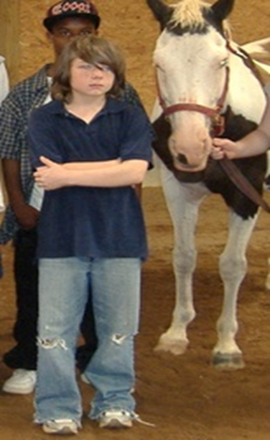
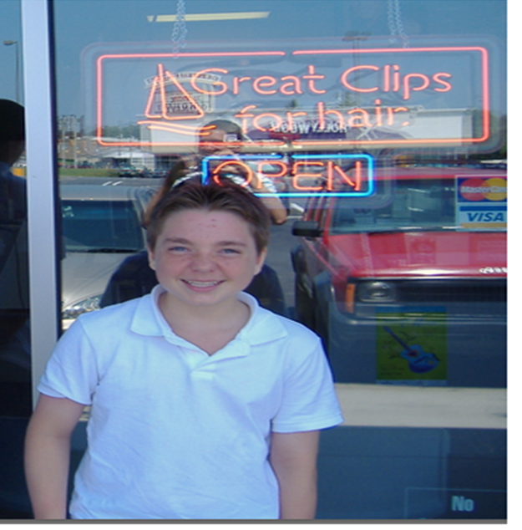
Psychosocial rehabilitation services
Using this service to teach skills can be vital to effective treatment.
Skills must be taught and mastered BEFORE behavior modification or interventions can be effective with children.
Using school breaks to teach and re-inforce skills can make treatment more effective.
BEFORE
AFTER

Slide 27
Behavior modification
BMod is a service used when needing to coach children or adolescents to use behaviors.
BMod includes modeling from the clinician.
BMod uses rewards and consequences to shape the behaviors of children and teens.
This service can be effective when helping children to apply skills and abilities that they have learned in therapy or PRS.
GOAT Biking Trips

Slide 28
The solutions: billable services
Billing for services provided creates income for community mental health centers.
Estimating projected revenue based on the types of services your team plans to provide allows you to “set aside” money to plan for engaging activities to use for children and adolescents.
Spending a small portion of this expected revenue on the front end to make services during school breaks engaging will result in larger returns on your investment through reduced no shows and improved attendance of services.
Group therapy and group PRS services allow for a greater volume of billing.
School breaks can be ideal for implementation of group therapy, since groups are generally meant to be short-term and with a specific goal or focus for all of the group members.
Billable services are only one option to help with overcoming resource barriers.

Slide 29
The solutions: billable services
Leadership and quality assurance departments across centers vary in their views and philosophies.
Talking with your senior leadership and QA about the services you can provide, their benefits to clients, and their help in developing sustainable finance models may be important.
If your QA or senior leadership limits in one way, look for other ideas that you CAN implement.

Slide 30
The solutions: Community involvement
Engaging the community in your plan for services can help to overcome resource barriers.
Contacting local businesses could result in donations or discounts as many want to help children in need.
Contacting local churches, faith communities, and non-profits can also result in donated supplies and food, donated experiences, and help from volunteers.
Humane Society of Greenville, SC

Slide 32
Implementation
What activities would you like to do with your clients this summer?
What services could you include before, during, or after?
What community partners would you need to provide these activities?
What is your transportation plan?
Can your center support any of the funding needed for these activities?
What additional sources of financial support might you need?
When can you talk to your center’s leadership about your ideas?

